Slide 1
AP+ Industry Project
Background
October 2025

Slide 2

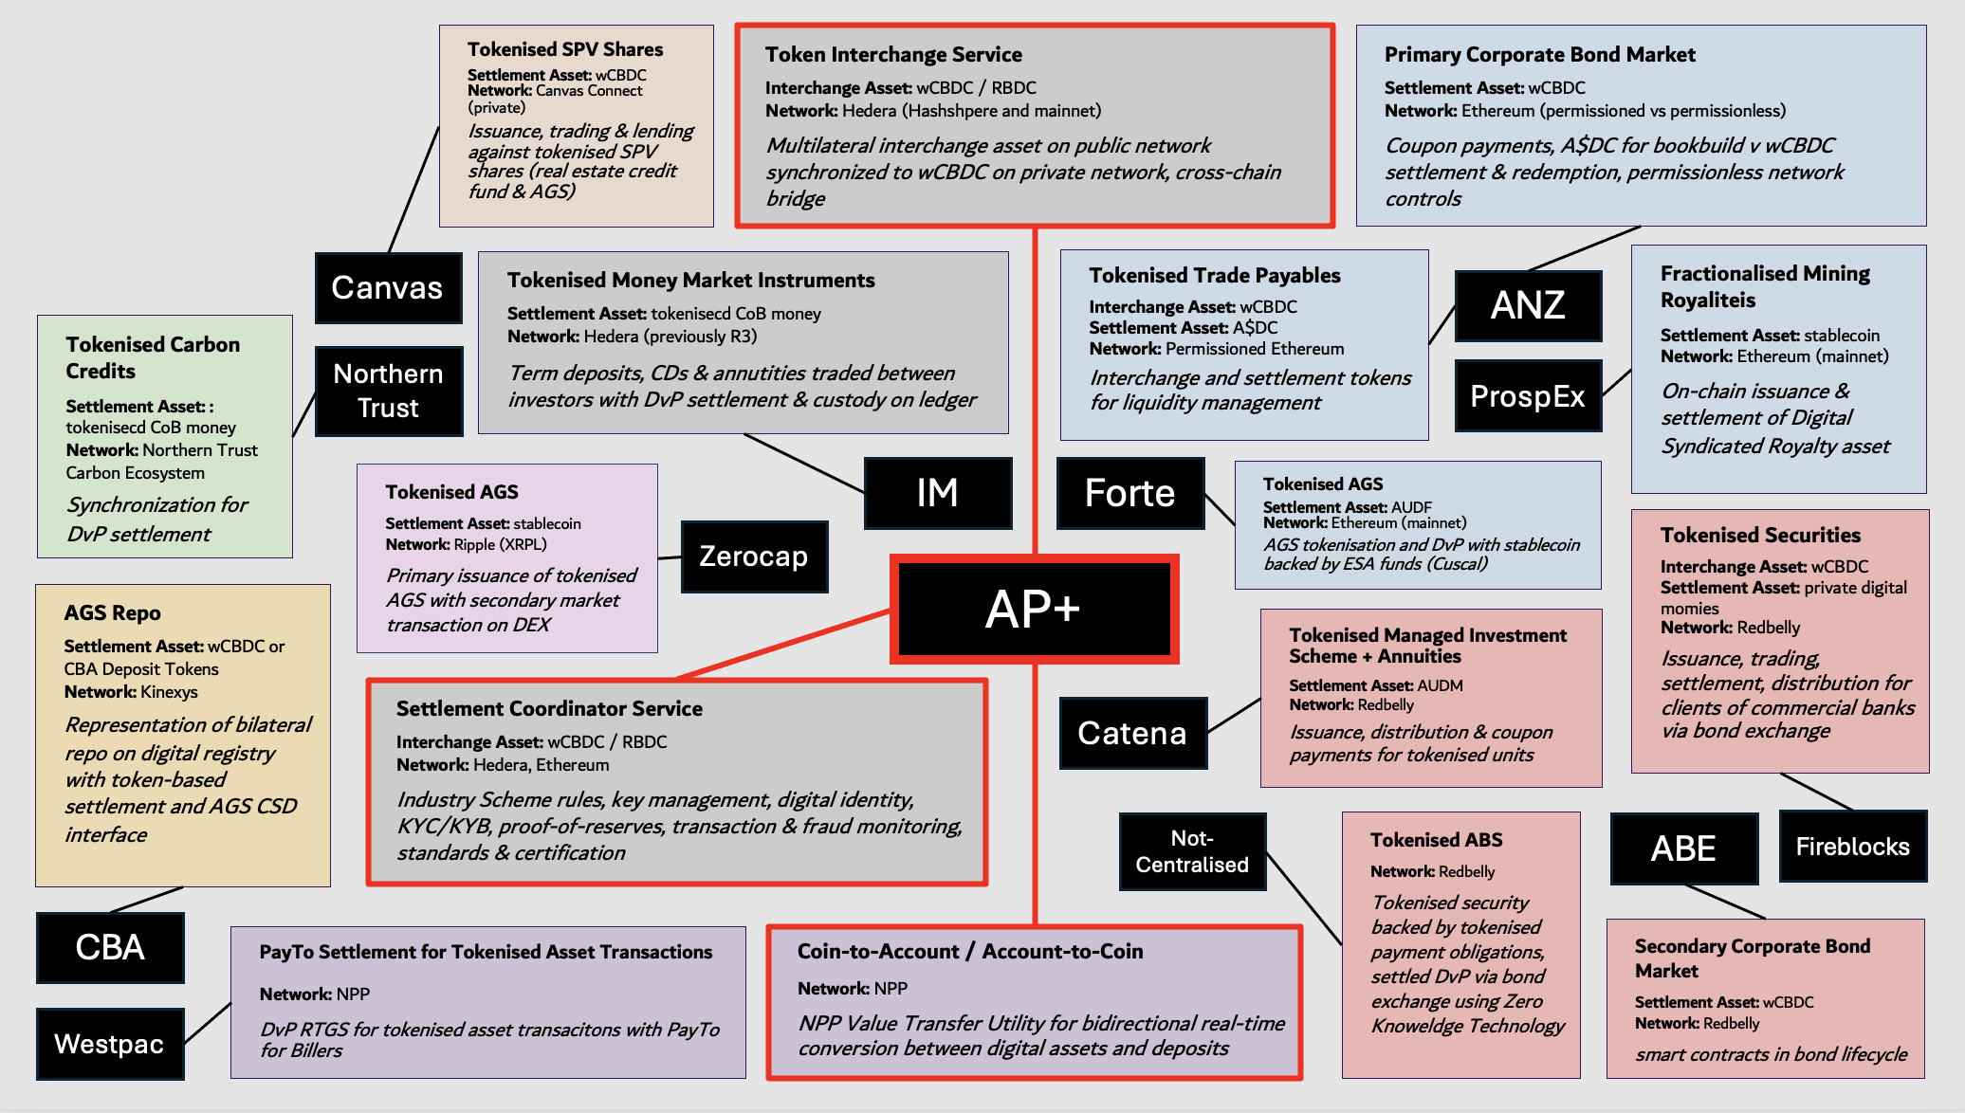


Project Acacia
Lead Entities
& Use Cases

Slide 3
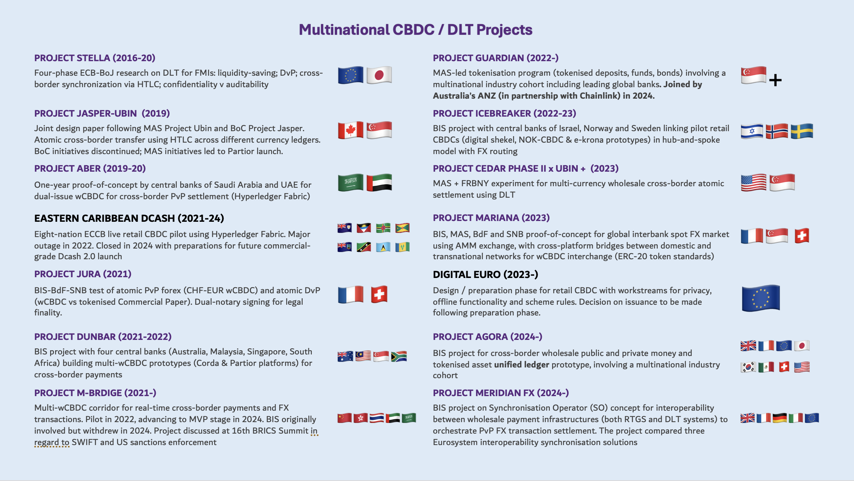

Slide 4
Public and Private Money
The distinction between public & private money is essential context for Project Acacia
Public money (currency)
Central bank (CeB) money a.k.a. M0 or MB (Money Base)
Sovereign fiat liabilities: issued as currency by a central bank
Settles tax obligations but not convertible to any reserve
Supported by central bank assets including repo, forex and bond holdings.
Australian public money exists in two forms:
  electronic: ESA balances in RITS. Held by institutions
  physical: banknotes / coins. Held by the public
CBDC would be a new digital form of public money outside RITS.
Project Acacia is considering only a wCBDC held by institutions
Private money (deposits)
Commercial bank (CoB) money a.k.a. M1 although “M1” includes physical currency also
Commercial bank cash liabilities: an interest-bearing debt issued by a bank to a depositor
Supported by commercial bank assets, including reserves and loans
  Reserves are ESA Balances (M0), which settle interbank payments in RITS (real-time gross or batch netted)
  Fractional-reserve banking generates M1 as a multiple of M0: bank loans (of M0) create new bank deposits (M1)
Most Authorised Deposit-Taking Institutions (ADIs) are commercial banks, although some non-banks are also authorised to issue deposits (e.g. Cuscal Limited)
M3
A$ 3.3 T
A “deposit-taker” (ADI) is also called deposit issuer, since deposits are financial instruments issued to depositors.
Only ADIs can issue deposits, but non-ADIs can issue Stored Value Facilities (SVFs), instruments allowing customers to store funds for the purposes of making future payments, including prepaid cards and mobile ‘wallet’ or online account balances (e.g. PayPal, Alipay). These are money-like claims on a private issuer, but not M1.
M1
A$ 1.9 T
MB
A$ 0.3 T
M1 deposits are call deposits: transferrable (convertible to M0) at par value on demand / without tenor
Less liquid deposits (e.g. term deposits) are included in M3

Slide 5
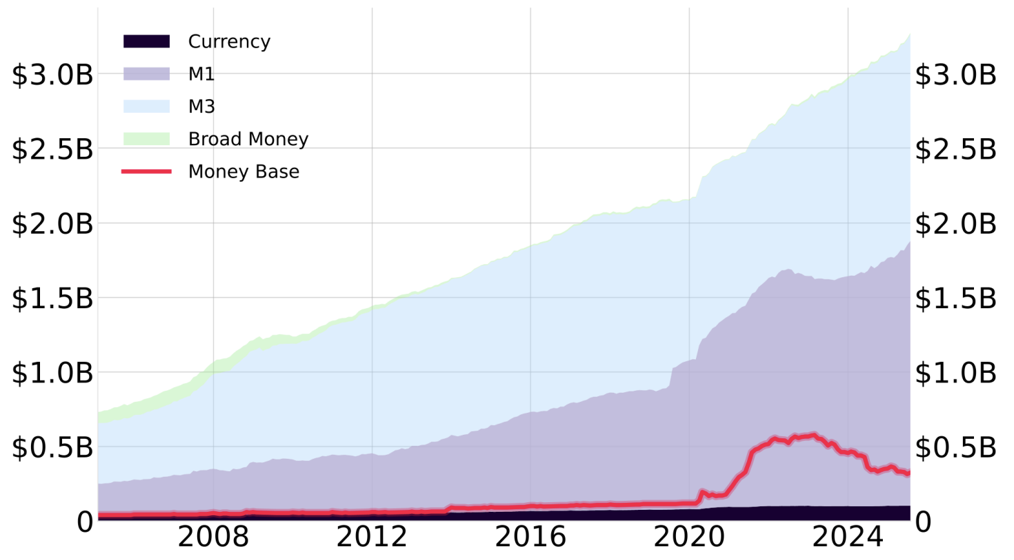
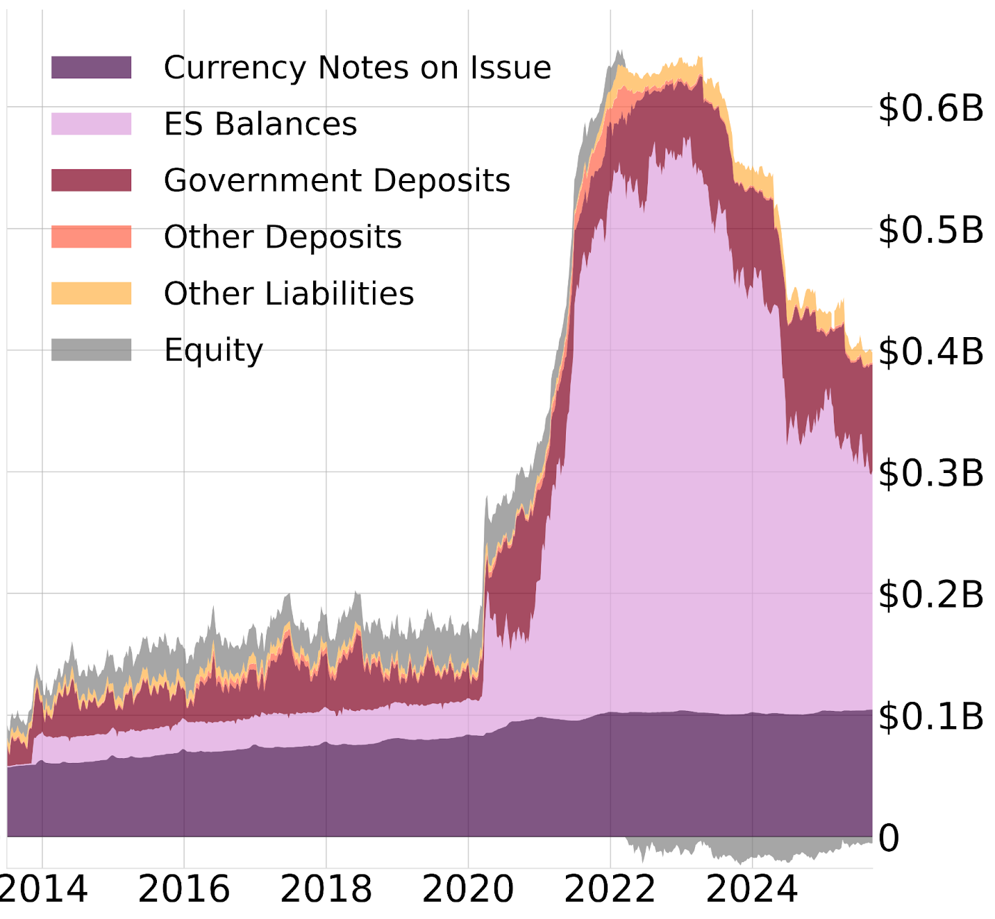
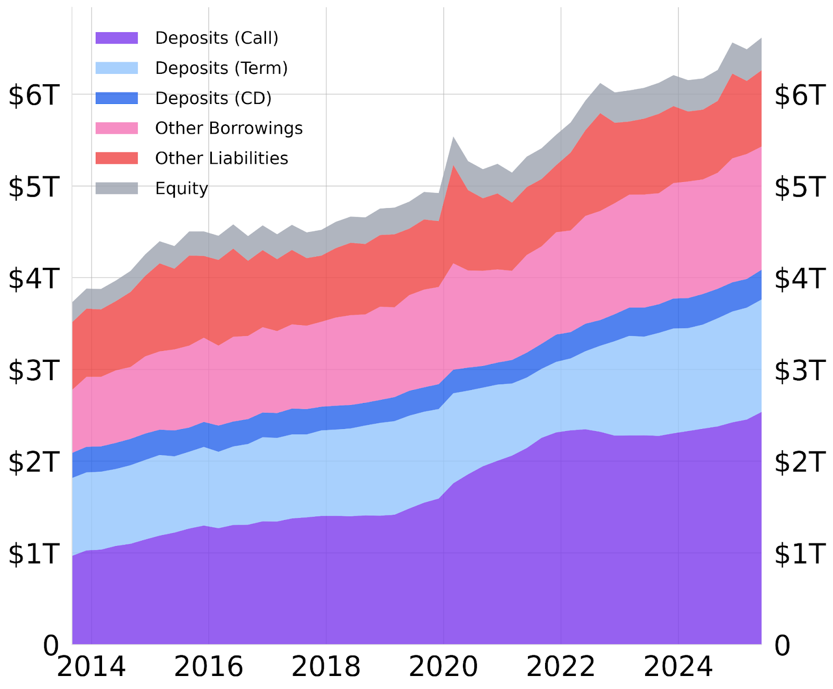
RBA Aggregates
Monetary Aggregates
M1: physical currency + transferrable (a.k.a. call / cash / demand) deposits at ADIs
M3: M1 + all other deposits at ADIs including term deposits and certificates of deposit
Broad Money: M3 + short term liquid liabilities issued by non-ADIs
The RBA refers to central bank money as MB rather than M0
ES balances (in RITS) are part of MB but not M1
Physical currency (banknotes + coins)
are included in MB & M1
MB
Tokenised Private Money
Deposit tokens issued by domestic ADIs would be legally equivalent to deposits. Deposit tokens without tenor would be categorised with call deposits in monetary aggregates (M1). Project Acacia experiments will feature tokenised term deposits & CDs; tokenised M3.
Stablecoins can be issued by non-ADIs and are not included in any monetary aggregate. Treasury’s proposed regulatory framework classifies stablecoins as a special type of SVF that is “used [for payments] without the direct involvement of the issuer”. Including SVFs in monetary aggregates would ‘double count’ the issuer’s liability along with the deposits held by the issuer as its necessary liquid backing assets.
Tokenised MMFs are shares in regulated mutual funds investing in short-term low-risk assets, issued as stable-value yield-bearing tokens and useful as programmable collateral. Tokenised MMFs are issued by BlackRock, Franklin Templeton, UBS, Fidelity International & Circle. Goldman Sachs & BNY Mellon also recently announced a MMF tokenisation initiative.
Other RBA liabilities to private non-banks (not in M1)
A future legislated CBDC (retail or wholesale) would be a new MB component
CeB Liabilities
CoB Liabilities

Slide 6
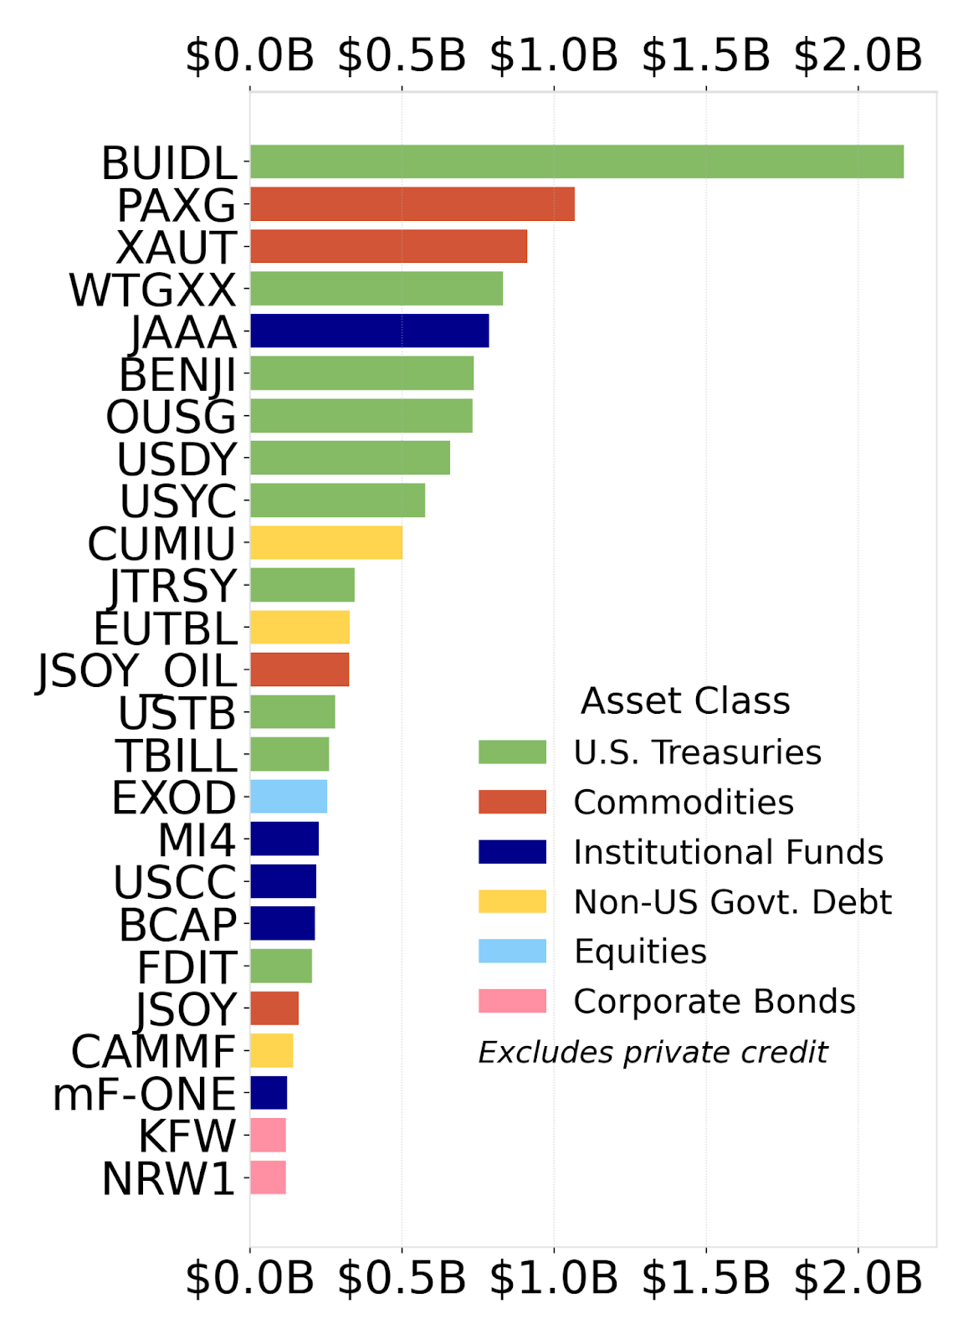
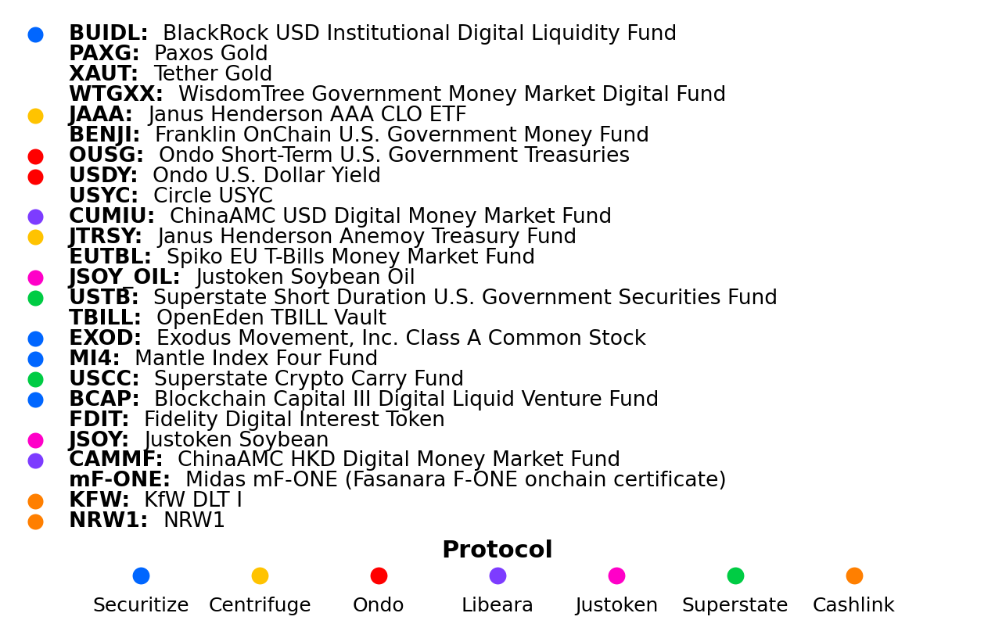
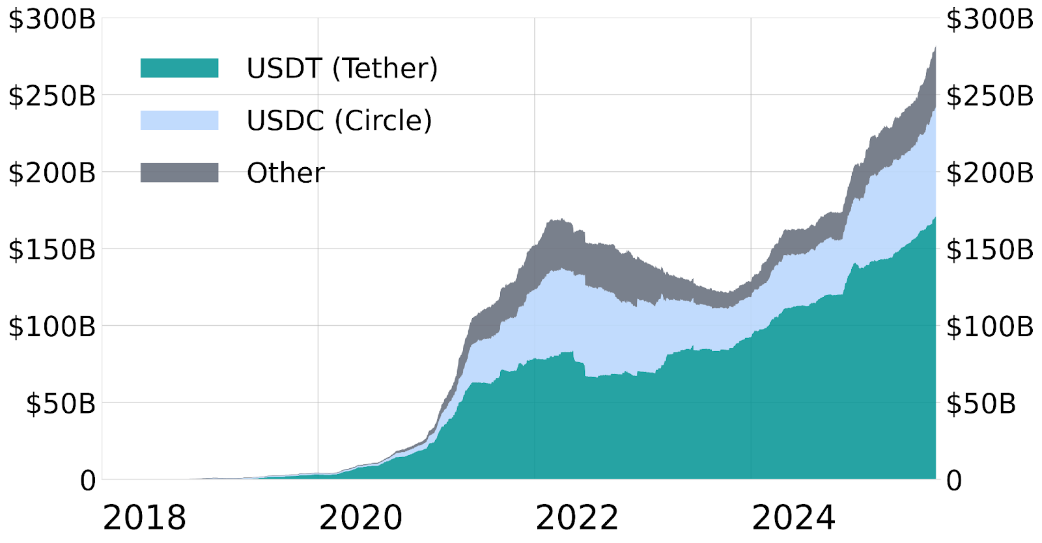
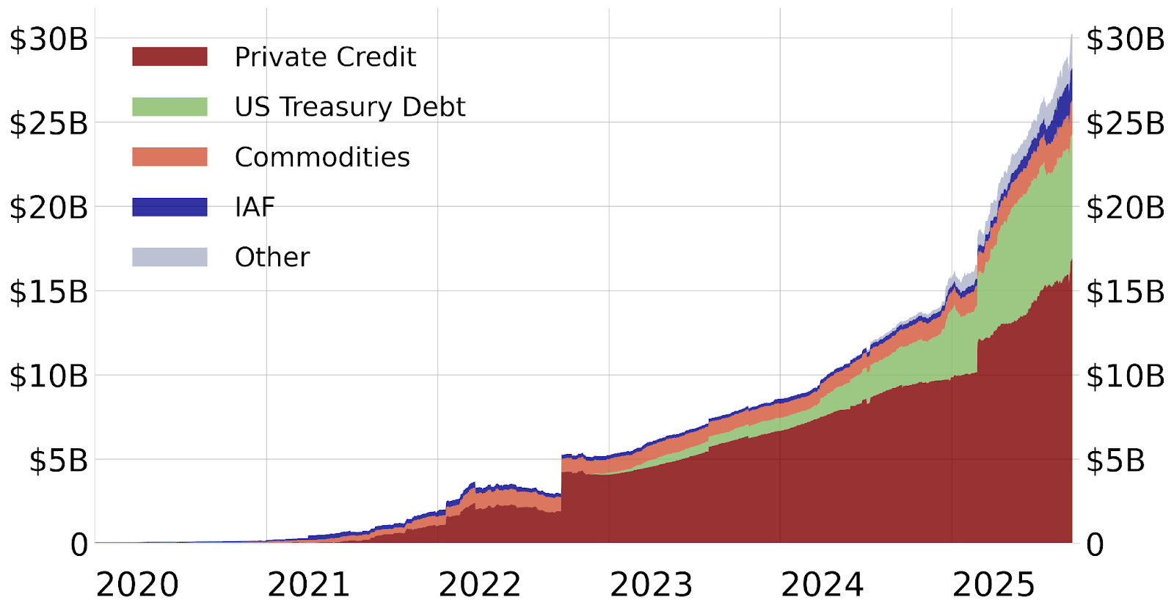
Tokenised RWA Issuance
Tokenised RWA Value (USD)
US Treasuries (led by BlackRock) and gold are the top tokenised assets, excluding HELOC’s ~$12B
New Regulatory Regimes
Jurisdiction: Stablecoins Framework | Liquidity Requirements: all jurisdictions require 100% backing
🇪🇺 EU: MiCA (2024) | Minimum proportion (30-60%) in CoB call deposits with concentration limits, remainder in HQLA; reserve assets, segregated accounts. No interest permitted.
🇺🇸 US: GENIUS Act (2025) | CoB call deposits, short term Treasury securities (up to 93 days maturity), overnight repos / reverse repos, MMF shares; segregated accounts, no interest
🇯🇵 Japan: Electronic Payment Instruments amendments (2023) | Cash, CoB call deposits, government / municipal bonds; funds segregated and held by legal trust entities
🇸🇬 Singapore: SCS framework (2023) | Cash, CoB deposits & government debt (AA- equivalent) up to 3 months maturity; segregated accounts. Max T+5 business day redemption.
🇭🇰 Hong Kong: Stablecoins Ordinance (2025) | Cash, CoB deposits with tenor up to 3 months, government issued or guaranteed debt with up to one year residual maturity, reverse repo, funds
🇦🇪 UAE: Payment Token Services Regulation (2025) | Domestic currency: 100% escrowed deposits. Foreign currency: 100% HQLA
🇨🇭 Switzerland: FINMA Guidance (2024) | Reserves held as CoB deposits covered by Swiss default guarantee
🇬🇧 UK: Final standards under development (FCA/BoE) | Under transitional FCA rules, at least 5% CoB call deposits, the rest in HQLA
Stablecoin Issuance (USD)
99.8% of issued stablecoins are USD denominated
RWA Issuance
The largest component comes from the US HELOC lender Figure
Figure HELOC

Slide 7
Monetary Singleness: a case for a national industry scheme
The AP+ Project Acacia pilots are designed to highlight the key upgrades necessary for Australia’s payments & banking infrastructure to effectively interface with the emerging token-based financial ecosystem. The core mechanism is a Token Interchange facility for exchange of par-valued AUD tokens, managed under an industry Scheme to enforce the use of a common multilateral interchange token 100% backed with central bank money. This can extend the singleness of money to privately-issued AUD tokens on public ledgers. During the pilots, central bank money will take the form of private-network wCBDC. However, the Scheme could also operate without a CBDC, by synchronising the interchange token directly to RITS.
A Future Payments Scheme can serve a key national interest in financial stability during an unpredictable transition period for banking and payments industries globally.
  Central bank money is a government liability & a commercial bank asset used to settle interbank payments by commercial banks’ depositors
Central bank money deposited in a commercial bank becomes a reserve. The depositor’s commercial bank money is a claim to equal reserves when using the deposit to make interbank payments or when withdrawing physical currency.
  The deposit is an asset of the depositor and a cash liability of the commercial bank
  The bank must make reserves (liquidity) available on demand for the depositor’s interbank transfers or physical cash withdrawals
  Reserves otherwise support acquisition of other bank assets (i.e. loans). The deposit effectively represents a claim on these assets, since the full value in reserves is not held for every depositor
+
-
-
+
Interbank Payments Settlement & Fungibility of Deposits
A buyer purchases an asset from a seller. Unless the buyer is an ESA holder (or paying with physical currency), traditional payment must come from the balance of the buyer’s commercial bank deposit.
If buyer and seller have accounts with the same commercial bank, payment could be made internally within that bank. The seller receives a deposit – a commercial bank liability – without any movement of central bank liabilities (cash). The commercial bank balance sheet is unchanged: the buyer’s deposit is now the seller’s deposit.
If buyer and seller use different commercial banks, payment must be made interbank using RITS. The buyer’s commercial bank liquidates the buyer’s deposit and sends “cash” (ES balances) to the seller’s commercial bank, which creates a deposit for the seller (a liability of the seller’s bank).
The seller still receives a deposit as payment, but the use of RITS to settle interbank payments makes deposits at different commercial banks fungible (equivalent in value). Banks’ exclusive acceptance of ES balances as a multilateral settlement asset secures the singleness of the currency. Australia’s domestic FMIs are (non-ADI) ESA holders that settle securities & derivatives transactions using central bank money, even when counterparties to trade share the same commercial bank.
RITS was launched in 1998, but for two decades RTGS was limited to wholesale payments; Austraclear transactions and transfers made under the SWIFT High Value Clearing System managed by APCA (now AusPayNet). With the NPP in 2018, domestic retail payments also became real-time, facilitated by the FSS and its ISO 20022 messaging standard (the NPP Basic Infrastructure is designed, built & operated by SWIFT).
The 120-character ABA file format still used for direct-entry electronic payments emerged from 1970s punch-card technology. Deferred batch clearing was managed via various interbank agreements before APCA established a common framework in 1994 (BECS). Household internet access led to the industry launch of BPAY as a retail payments scheme (employing BECS) in 1997. Eftpos (first introduced with magnetic strip & PIN in the 1980s) was reformed into a multilateral card scheme in 2009, partly to better respond to market competition driven by innovations such as contactless and EMV.

Slide 8
Financial Market Infrastructures
The RBA recognises two FMIs as Systemically Important Payment Systems (SIPS) for Australia:
RITS: RBA’s internal ESA transfer system for domestic interbank payments
CLS: an international institution operating multicurrency PvP FX settlement for wholesale spot FX transactions (responsible for over half of global FX transactions)
The RBA also supervises other FMIs operating in Australia, assessing compliance with Financial Stability Standards based on the international CPMI-IOSCO PFMIs.
SSFs – Securities Settlement Facilities (delivery of asset on payment)
  Austraclear: wholesale OTC debt (government bonds and repo)
  ASX Settlement: exchange-traded equities & debt products (CHESS)
  Euroclear (Belgium): debt and equity securities, government bonds and repo
  Clearstream (Luxembourg): debt and equity securities, government bonds and repo
CCPs – Central Counterparties (clearing)
  ASX Clear: equities & debt products, exchange-traded & OTC
  ASX Clear (Futures): exchange-traded equitiy and debt products
  LCH (UK): OTC interest rate & inflation rate derivatives
  CME (US): interest-rate, commodity and energy derivatives
The four Australia-based FMIs are all ASX Group entities.
Wholesale & Retail Money
Millions of retail transactions processed daily by RITS collectively account for less than 5% of average daily value transacted. The other ~95% comes from high-value, low-volume wholesale payments, generally associated with institutional securities (DvP) and FX (PvP) markets. RTGS was previously reserved for wholesale transactions but was extended to retail with the launch of the FSS in 2018 (enabling the NPP).
Central banks distinguish retail and wholesale CBDCs. The RBA has limited Project Acacia’s scope to wCBDC, arguing that a tokenised form of physical currency is unlikely to improve efficiency of domestic retail payments (which are now instant), but could introduce financial stability risks with a new non-physical public money alternative to bank deposits. By contrast, the RBA has noted various inefficiencies in Australia’s wholesale market infrastructure and has suggested that the introduction of wCBDC could help modernise processes relating to clearing & settlement.
ASX Group owns and operates monopoly infrastructure for Australia’s core domestic markets. Transactions depending on the SSF Austraclear (the AGS CSD) are used to fund the federal government and implement monetary policy, Australclear connects directly to RITS for RTGS & DvP RTGS during business hours. ASX Settlement (the other major Australian SSF) operates the CHESS system for equities, which settles DvP on a T+2 net basis – ASX Settlement submits these netted payments to RITS as batch administrator. RTGS for equities is technically supported by CHESS but has never been in use. ASX Clear is the equities CCP that novates trades & submits settlement to CHESS. ASX Clear Futures is the CCP for futures & options (interest-rate, equity-index, energy/commodity) traded on the ASX platforms, as well as some OTC derivatives.
ASX Group led an unsuccessful attempt to develop a token-based platform from 2016 to 2022 (hiring Digital Asset, creator of the Canton Network), eventually abandoning the project after spending A$250 million and misleading regulators on the state of progress. The project’s failure means that the aging CHESS system will continue operating for a number of years longer than intended (a non-DLT replacement is planned). In 2024, CHESS suffered a significant operational incident (following a previous one in 2020) drawing unusually strong rebuke from regulators.
The PFMIs are international regulatory standards published in 2012 to guide supervision of payment systems, CSDs, SSFs, CCPs and trade repositories. The Principles arose out of the international policy response to the 2008 financial crisis and cover several broad categories of risk: Legal, Credit, Liquidity, Business, Custody & Investment, and Operational.
A consequence of the financial crisis was a G20-led international policy initiative to mandate the centralised clearing of OTC derivatives. Contracts novated by CCP are collateralised with holdings of initial margin (HQLA) set to cover extreme-but-plausible stress scenarios, and variation margin, to be paid with central bank money “where practical & available”.

Slide 9
Liquidity Issues for Token Interchange
The essential elements of a Future Payment Scheme are broadly outlined in three AP+ ‘use case’ submissions accepted by the Reserve Bank for Phase 2 (‘Experiment’) of Project Acacia:
NPP-Token Integration (Coin to Account / Account to Coin). Bi-directional transfer of value between tokens and fiat using ISO20022 and EVM standards. How the NPP can be utilised to support digital asset settlement through the intermediation of ESA holders and the participation of SWIFT.
Token Interchange. Neutral operator of a permissioned public ledger-based platform for Scheme members to atomically swap stablecoins and deposit tokens. The interchange will utilise an EVM-compatible tokenised mirror representation of Central Bank Money (“M0”) as cross-asset ‘hub token’ for settlement, employing smart contracts for token swapping. The interchange operates on a permissioned instance of Hedera Hashgraph and incorporates an inter-ledger bridge to Ethereum.
Settlement Coordinator Services. Supporting services for NPP-token integration and token interchange, Another Project Acacia lead entity has since become the lead entity for this use case, with the experiment proposing to tokenise tradeable Certificates of Deposits and Annuities for Australian money markets, settling with a privately issued stablecoin.
Project Acacia Consultation Paper Models
Settlement coordinator between tokenised asset market and RITS (ES balances)
Atomic settlement in asset markets using tokenised public money (CBDC)
Atomic settlement in asset markets using tokenised private money (deposit tokens), settlement coordinator between private money tokens and RITS (ES balances)
Atomic settlement in asset markets using tokenised private money (deposit tokens), token interchange of private monies without a common settlement asset
Atomic settlement in asset markets using tokenised private money (deposit tokens), token interchange of private monies with common ‘public money’ settlement asset (RBDC / CBDC)
How will the emerging digital token economy affect the management of institutional liquidity?
What are the liquidity requirements of digital token interchange systems?
How do these requirements affect integration with existing financial market infrastructures?
How can institutional schemes support resilient and efficient systems for digital token interchange?
To what extent does the programmability of tokenised money and assets allow schemes to be implemented as code?
Project Components
Review of institutional liquidity management, tokenisation-related initiatives by systemically important financial institutions, cross-disciplinary academic literature.
Evaluation of the impact of stablecoins (and their regulatory collateral requirements) on domestic and cross-border money markets. Scheme options for assessing operational liquidity requirements for token-fiat conversion. Evaluation of hub-token architectures and the use of common settlement assets for multilateral token exchange. Comparison of distributed ledgers and synchronisation mechanisms.
Simulation of the impact of money tokenisation on systemic liquidity and financial intermediation using networks of agents. Simulations and adaption of financial stress-testing methodologies to multi-chain, multi-asset arrangements for programmable tokens and automated markets. Technical and operational Scheme design recommendations that effectively address failure scenarios and support monetary policy objectives.

